Slide 1

A preliminary review on: surrogate models for stormwater networks
Mohammad Movahhed
AI for Urban Water Networks
Instructor: Dr. Fan

Slide 2
Why surrogate modeling?
Climate change
Surrogate modeling
Resilient infrastructure
Need for accurate flood realization
Efficiency
Role of stormwater drainage network
Saint-Venant Equation
Physics-based models
Accuracy
Notes:
PM are not suitable for repetitive simulation/optimization and also real-time decision making and control management
These models bypass the computational intensity of HFHMs by learning the relationships between input parameters and output responses directly from precomputed simulations
SMs can be easily coupled together

Slide 3
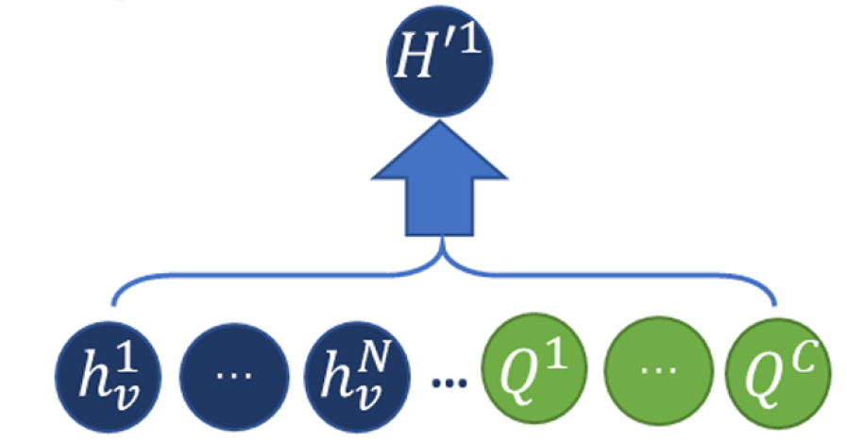
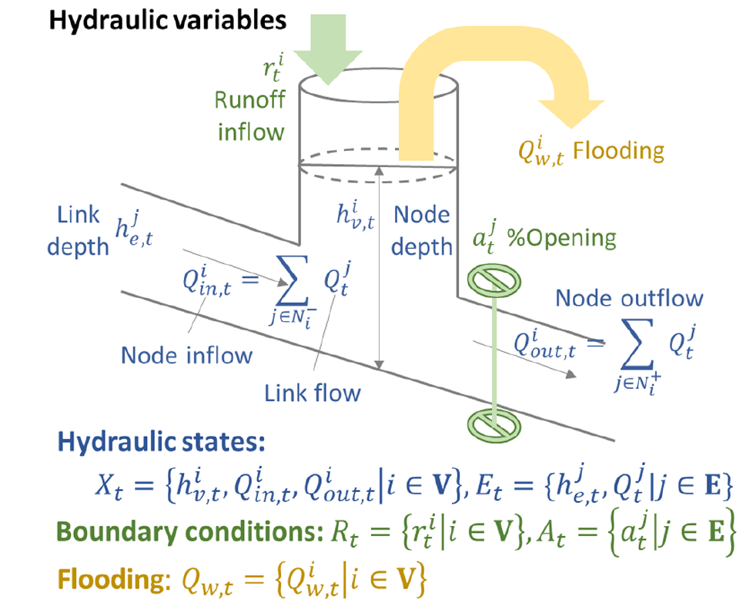
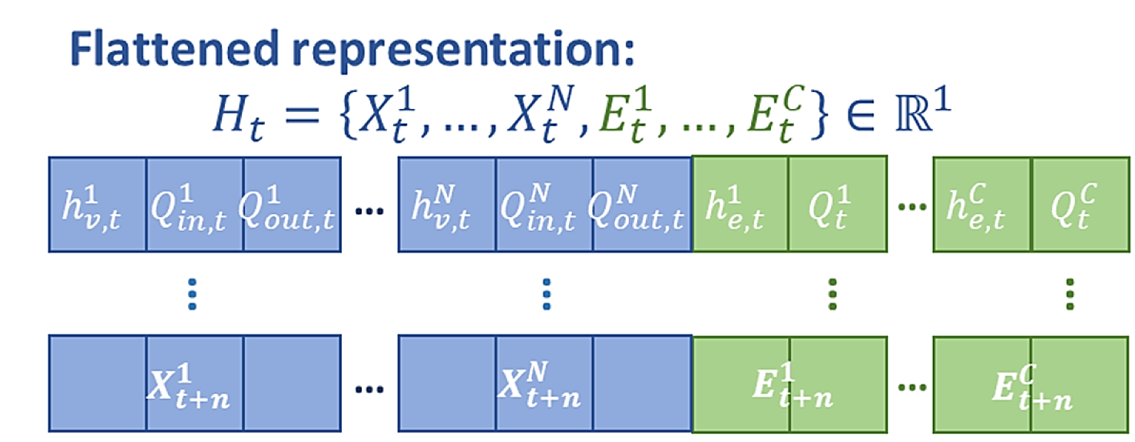
Conventional neural networks as surrogate models
Neural Network

Slide 4
Machine learning-based surrogate models
Surrogate model | Computational savings | Accuracy | Reference
MLP with 8 hidden layers | 99.6% | Mean relative errors between 2% and 62% | Kim and Han, 2020
Ensemble of 100 MLPs | 80%–90% | Nash-Sutcliffe efficiency (NSE) 0.66<NSE<0.92 | Zhang et al., 2019
Radial basis neural network | Not reported | 0.273 Sum Squared Error | She and You, 2019
Recurrent neural network | Not reported | NSE (>0.97), NRMSE(<0.26) | Chiang et al., 2010
Notes:
Nash-Sutcliffe efficiency (NSE) is calculated by subtracting the ratio of the error variance of the modeled time-series from the variance of the observed time-series from 1.

Slide 5
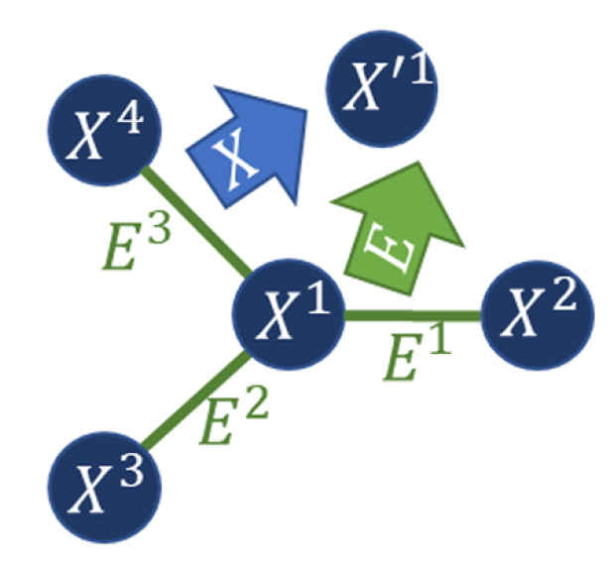
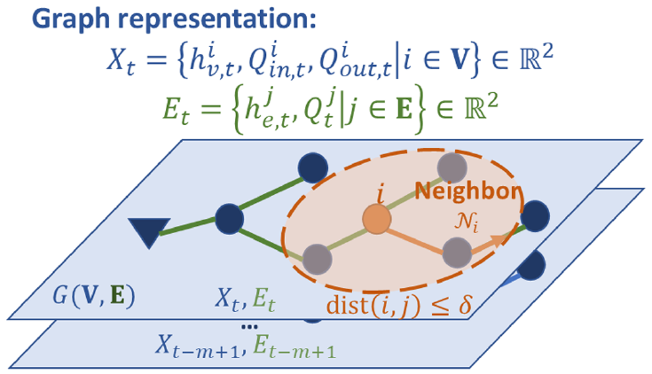
Graph Neural Networks (emerging alternative)
GNN advantages:
Fully-connected NNs have redundant neural connections.
GNNs can naturally capture and propagate information across nodes connected via edges.
GNNs can infer missing data using neighboring node embeddings
In stormwater networks:
Drainage flow routing follows the topological structure from upstream to downstream, and hydraulic state transitions are highly related to neighbors in the drainage network.

Slide 6
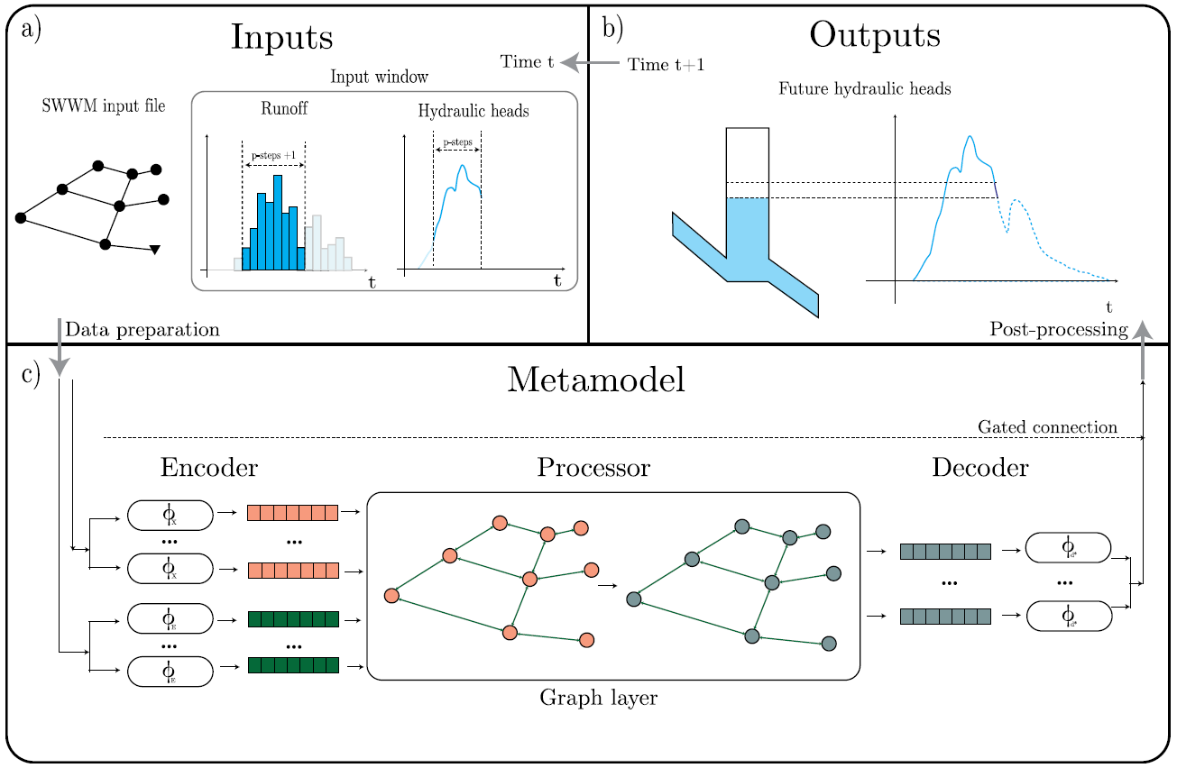
GNN-based surrogate model
Garzón et al. (2024)

Slide 7
Spatio-temporal GNN-based surrogate model
Zhang et al. (2024)

Slide 8
Identified gaps
Physics-guided constraints can be applied to the output of GNNs to improve their prediction capability.
Real stormwater networks are dynamic, with infrastructure updates and failures. A dynamic GNN can better represent the network rather than a static graph.
No GNN-based stormwater surrogate model is yet developed for coastal flooding.
Such model can be coupled with the hydrodynamic flood model to simulate the propagation of flood in urban areas more accurately.
Notes:
Surcharge caused by storm

Slide 9
References
Chiang, Y.M., Chang, L.C., Tsai, M.J., Wang, Y.F. and Chang, F.J., 2010. Dynamic neural networks for real-time water level predictions of sewerage systems-covering gauged and ungauged sites. Hydrology and Earth System Sciences, 14(7), pp.1309-1319.
Garzón, A., Kapelan, Z., Langeveld, J. and Taormina, R., 2024. Transferable and data efficient metamodeling of storm water system nodal depths using auto-regressive graph neural networks. Water Research, 266, p.122396.
Kim, H.I. and Han, K.Y., 2020. Urban flood prediction using deep neural network with data augmentation. Water, 12(3), p.899.
She, L. and You, X.Y., 2019. A dynamic flow forecast model for urban drainage using the coupled artificial neural network. Water Resources Management, 33, pp.3143-3153.
Zhang, W., Li, J., Chen, Y. and Li, Y., 2019. A surrogate-based optimization design and uncertainty analysis for urban flood mitigation. Water Resources Management, 33, pp.4201-4214.
Zhang, Z., Tian, W., Lu, C., Liao, Z. and Yuan, Z., 2024. Graph neural network-based surrogate modelling for real-time hydraulic prediction of urban drainage networks. Water Research, 263, p.122142.

Slide 10
Thank you for your attention

